Slide 1


BigFix Foundation
BESFND101 – BigFix Platform
Architecture

Slide 2

Contents
BigFix Architecture - Components
Basic Architecture
Network Flow
Keys and Certificates
Relay Architecture
Client Evaluation Loop

Slide 3
BigFix Foundations
BigFix Architecture - Terms

Slide 4
BigFix Platform - Overview
BigFix is a single, comprehensive solution for managing connected and roaming endpoints running Windows, Linux, Raspbian, Unix and MacOS.
A single BigFix Server can manage up to 300,000 physical or virtual devices over private or public networks. These include servers, desktops, roaming laptops, mobile phones, Point-of-Sale devices, automated Teller Machines, and self-service kiosks
A single intelligent agent continuously assesses the state of each endpoint with the deployed policies whether or not the endpoint is connected to the network. If the endpoint is out of compliance, it informs the BigFix server.
The state of the endpoints are viewed and managed using either the BigFix Console or the WebUI. Using these tools, operators can view whether managed devices are compliant with deployed policies and can take action to remediate out of compliance devices.
Relays are deployed in a hierarchy to help manage the distributed devices and cache policy content and downloads such as patch binaries.

Slide 5
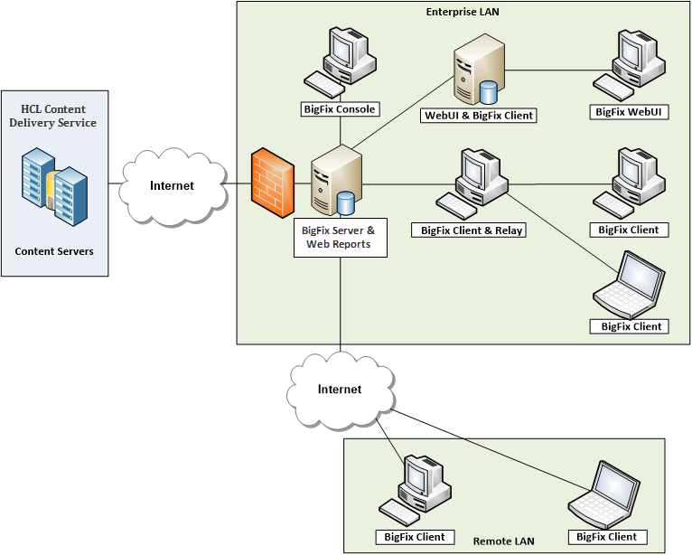
BigFix Components – Root Server
The BigFix Server also referred to as the Root Server is manages all devices.
Can manage up to 300,000 devices.
Checks for updated content once per hour from the Content Delivery Servers and license updates once per day.
GatherDB inserts new content in the database.
Receives reports from managed endpoints forwarded through the Relays infrastructure.
FillDB inserts client reports into the database.

Slide 6
BigFix Components – Clients
The BigFix Client is installed on each device that is fully managed by BigFix
The client is sometimes referred to as the BigFix Agent, and it is responsible for evaluating content in its local repository and reporting the results of the evaluation upstream.
The client runs in a continuous loop called the Evaluation Loop.
CPU usage is managed by the sleep/wake cycle settings of the client. By default, these parameters are set so that the client uses on average 2% CPU over a 24 hr. period.

Slide 7
BigFix Components – Relay
The BigFix Relay is and enhanced client. It is responsible for the following:
  Sending downstream notifications of new content.
  Caching downloads such as patch binaries.
  Receiving reports from downstream components and forwarding them upstream.
Relays in standard configuration can support up to 1000 endpoints.
Relays in high scale configuration can support up to 5000 endpoints.

Slide 8
BigFix Components – Web Reports
BigFix Web Reports is the primary reporting interface.
Web Reports can be co-located with the BigFix Root Server or distributed.
Multiple instances of Web Reports can be deployed.
Multiple datasources can be defined to consolidate reporting from multiple BigFix Servers.
The Web Reports database only contains information about users, and report definitions. The BigFix data is retrieved using a cached copy of the BFEnterprise database which is updated every 15 seconds by default.
The default Web Reports ports are:
  HTTP Redirect Port: 8080
  HTTPS SSL Port: 8083

Slide 9
BigFix Components – WebUI
BigFix WebUI can be co-located with the Root Server in small environments or installed on a dedicated system.
Only 1 instance of WebUI is supported per BigFix Server.
If co-locating WebUI with the Root Server an additional 2 CPUs per 10 concurrent WebUI users is required.
WebUI augments the Console but does not replace it.
Users access WebUI through a supported Web Browser.
WebUI can support up to 36 concurrent users with the maximum of 300,000 endpoints.
The default SSL port for WebUI is 443.
The WebUI uses port 52315 for internal communication between WebUI and the Root Server.
If installing WebUI on a remote server, the following ports must all be opened: 5000 and 5001

Slide 10
BigFix Components – Console
The BigFix Console is a 64-bit Windows application that can be installed on any computer that is running a supported 64-bit Windows operating system.
The Console uses the BigFix port (52311 by default) to communicate with the BigFix Root Server.
The minimum recommended network speed between the Console and Root Server is 100 mbps.
The Console can be hosted on a Terminal Server or Citrix server.

Slide 11
BigFix Components – Content Servers
The HCL Content Delivery Servers are hosted in the cloud.
The BigFix Root Server checks for updated versions of the external site content every hour.
If new external site versions exist, the differences between the current version and the updated version are downloaded by the Root Server service. The updates are inserted into the database by the GatherDB service.

Slide 12
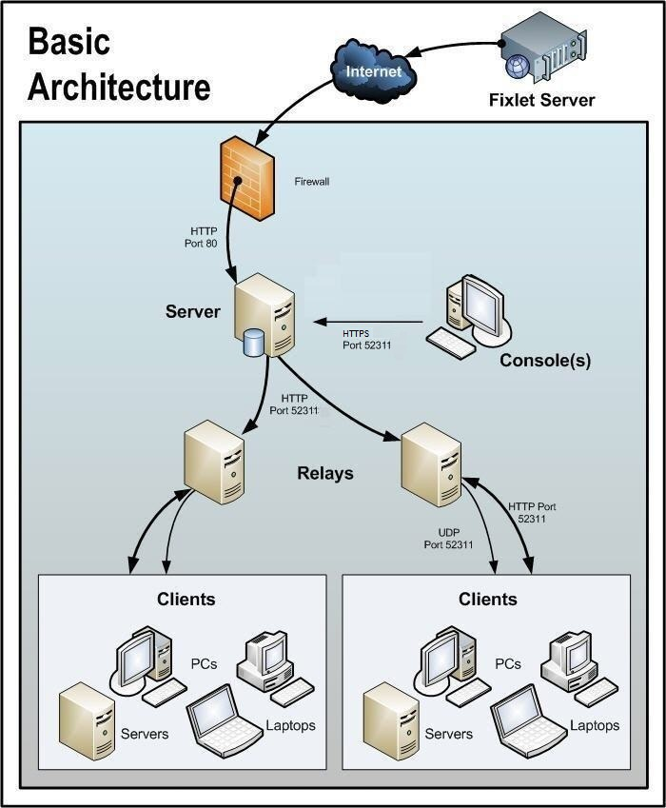
BigFix Components – Basic Architecture
Root Server to Content Server communication is via either ports 80 or 443.
The BigFix Platform uses a dedicated port for HTTP/HTTPS communication between the Root Server, Relays, Clients and Consoles. This port is 52311 by default. It is settable at installation but can not be changed without reinstalling.
Notifications of new content are made via downstream pings on the BigFix port using the following protocols:
  Server to Relay or Relay to Relay: TCP ping
  Server to client or Relay to client: UDP ping
After notification, the content is pulled down from the parent and cached.
Relays are used to reduce the load on the BigFix Root server and are placed close to the endpoints they manage from a network perspective.
The BigFix agent is installed on any device with a supported operating system that can benefit from OS patches or other updates.

Slide 13
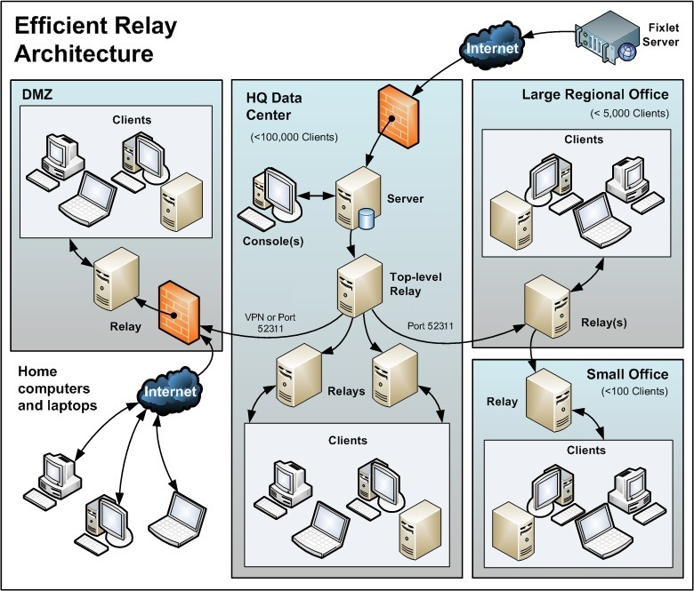
Relay Architecture
In large environments with many managed devices Top-Level Relays can be used to take more load off the Root Server.
A Top-Level Relay can manage up to 120 Relays.
All Leaf/Site level Relays are configured to used Manual Relay Selection so that they register with either a Top-Level Relay or another Relay in the hierarchy.
Ideally, the Relay hierarchy should consist of as few levels as possible unless there is slow connections and restricted bandwidth considerations.
Low bandwidth segments should utilize Relay-to-Relay communication.
Additional Top-Level or Site-Level Relays should be deployed as needed to support a failover scenario in the event a Relay goes down.
DMZ Relay(s) are deployed to manage Internet connected devices as well as servers located in the DMZ These Relays should be configured as Authenticating Relays to allow only trusted agents to register.

Slide 14
Manual Relay Selection
Systems that are configured to use manual Relay selection use the following process:
  Clients attempt to register with the Primary Relay first. The FQDN or IP address of the Primary Relay is stored in the client setting named: __RelayServer1
  The client attempts to register with the Secondary Relay if unable to register with the Primary. The FQDN or IP address of the Secondary Relay is stored in the client setting named: __RelayServer2
  If registration with the Secondary Relay fails, the client attempts to register with the Relays that are listed in the Failover Relay List. This is a semi-colon delimited list Relay FQDNs or IP addresses and is stored in the client setting named: _BESClient_RelaySelect_FailoverRelayList
  If all registration attempts fail, the client attempts to register with the Relay of last resort which is the Root Server by default. The Relay of last resort can be configured to use a Relay other than the Root Server by configuring the Last Fallback Relay option in the Masthead Management tab of the BigFix Administration tool.

Slide 15
Automatic Relay Selection
Roaming clients like laptops can be configured using Automatic Relay Selection so that they can automatically determine the best Relay to register with based on their network locations.
To enable Automatic Relay selection on an endpoint the client setting named __RelaySelect_Automatic is set to a value of 1.
The Automatic Relay Selection process works as follows:
  The client attempts to locate a Relay on its own subnet by sending ICMP pings based on hop count using a small TTL.
  If no response is received, the TTL is doubled, and the client sends out more ICMP pings using the increased TTL. This process repeats itself until a response is received, or the maximum number of hops is exceeded which is defined in the client setting named: _BESClient_RelaySelect_MaximumTTLToPing The default value for this setting is 20.
  If multiple responses are received, the client chooses one to register with.
  If no responses are received, the client attempts to register with the Relay of last resort which is the Root Server by default.
Automatic Relay Selection is performed under the following circumstances:
  At agent startup
  If the client is unable to communicate with the current Relay.
  Every 6 hours by default
  Optionally, when the IP address changes. To enable this behavior, the client setting named _BESClient_RelaySelect_AlwaysOnIPListChange must be set to a value of 1.

Slide 16
Relay Affiliation for Automatic Relay Selection
In certain cases, you might want to restrict which Relays that certain clients are allowed to select during the automatic Relay selection process. This can be controlled using Relay Affiliation.
Relay Affiliation only applies to the automatic Relay selection process
Clients and Relays can be added to affiliation groups so that the clients only attempt to select the responding Relays from one of their assigned affiliation groups.
Assign clients to Relay affiliation groups as follows:
  Create a setting named: _BESClient_Register_Affiliation_Seeklist
  Set the value to a semi-colon delimited string of affiliation group names
    Example: Americas;EMEA;DMZ
Assign Relays to Relay affiliation groups as follows:
  Create a setting named: _BESRelay_Register_Affiliation_AdvertisementList
  Set the value to a semi-colon delimited string of affiliation group names that correspond to the names in the client’s SeekList that you want to allow to register with that Relay.
    Example: EMEA;DMZ;*
Affiliation group naming rules
  The group names must not exceed 64 characters
  The asterisk (*) represents unaffiliated computers

Slide 17
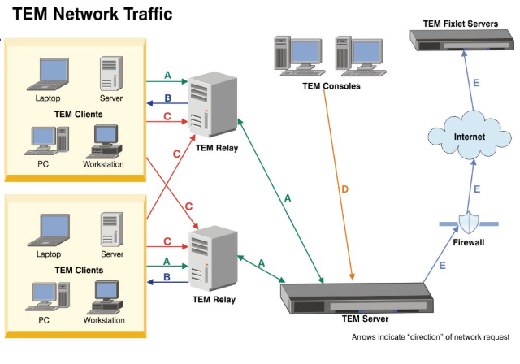
Network Traffic – Ports and Protocols
A-Traffic: Gather Content, Download files such as patch binaries, gather notifications, and post reports from the clients. This uses TCP, HTTP, HTTPS on the BigFix port which is 52311 by default.
B-Traffic: Relay to client or Server to client notifications using targeted UDP pings on the BigFix port.
C-Traffic: Automatic Relay selection ICMP pings.
D-Traffic: BigFix Console to Root Server communication via TCP, HTTP, HTTPS on the BigFix port.
E-Traffic: Content gathering from the Content Delivery servers via HTTP/HTTPS on ports 80 or 443
BES
BES Consoles
BES Clients
BES Relay
BES Clients
BES Relay
BES Root Server

Slide 18
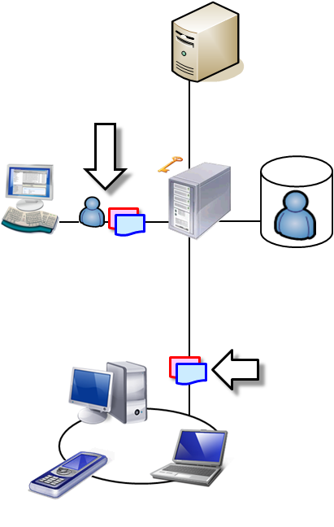
BigFix Keys and Certificates
Server signing key or certificate
  Is stored on the server; protected from server theft by Windows/Linux Crypto API
  Signs content for all users
  Signed by site administrator key, verifiable with deployment masthead
  Encrypts HTTPS traffic between server and Console
  In case of compromise, can generate a new server signing key from the site administrator key and revoke the compromised key
Site administrator key
  Used to rotate the server signing key and modify deployment configuration by using the administrator tool
  Must be stored in a secure location separate from the server
LDAP Server
User name and password plus content
BigFix Server
Consoles
Database of password-authenticated users
Signed
content

Slide 19
BigFix Actions
A BigFix Action is how an operator effects a change on an endpoint.
Examples: Applying a patch, installing software, and patching installed applications.
What happens during an action?
  The operator selects the Fixlet or Task and chooses the action to take
  The Take Action window opens, and the operator selects target devices and chooses other action settings like start time , end time, messages etc...
  The server notifies relays of the new action through a TCP ping
  The relays notify downstream relays through a TCP ping on the BigFix Port, and downstream clients through targeted UDP pings on the BigFix port.
  The client gathers the action, verifies the digital signature, and determines whether the action is applicable by evaluating the applicability Relevance
  If the action is applicable, the client runs the action and reports the results

Slide 20
BigFix Client Evaluation Loop
The BigFix Client continuously evaluates content in its local repository. Each client’s local repository contains BigFix content from the External or Custom sites that the endpoint is subscribed to. This content can include: Fixlets, Tasks, Baselines, Properties, Analyses, and Actions.
The client performs this evaluation using a Sleep/Wake cycle. The agent wakes up and processes content, sleeps, then wakes up and continues to process content. This cycle repeats until all the content has been evaluated. The client evaluation loop then starts over.
By default, the sleep/wake intervals are tuned so that the agent consumes approximately 2% CPU over a 24-hour period. The time required to complete 1 cycle depends on the number of items in the local repository that must be processed along with other factors.
The percentage of CPU that the client uses can be tuned by modifying the values of the following client settings that control the sleep/wake cycle. These setting are:
  _BESClient_Resource_WorkIdle – The default value in milliseconds is 10
  _BESClient_Resource_SleepIdle – The default value in milliseconds is 480
These settings can be changed by using Task ID 168 in the BES Support site

Slide 21
BigFix Client Evaluation Loop Behaviour
Performs Relay auto selection
  Verifies that the endpoint is connected to the best Relay based on network location
  Runs every 6 hours by default, or whenever communication is lost with the current Relay
Performs Client registration
  At agent startup and if Relay auto selection identifies a more appropriate Relay to connect to
Gathers content upon receipt of the UDP notification
  Gathers content from the parent Relay for the Master Action Site, all External and Custom sites that the client is subscribed to. It also gathers content for all the operator sites or Non-Master operators that have permissions to managed that endpoint.
  If UDP messages are not received, the client gathers content at least once every 24 hours by default as defined in the masthead.
Performs content evaluation and reports results upstream to its parent Relay
  Evaluates the applicability Relevance one document at a time and reports the results of all new evaluations and results that have changed since the last time they were evaluated.
  Runs action scripts for applicable actions in the Master Action site or Operator sites and reports results.
Sends a heartbeat message
  Posts a message to its parent Relay to show that the client is online
  Heartbeat messages are configured to be sent every 15 minutes by default

